Slide 1

Strong Authentication with Passwordless Authentication
WSO2 Identity Server Fundamentals

Slide 2
Authentication

Slide 3
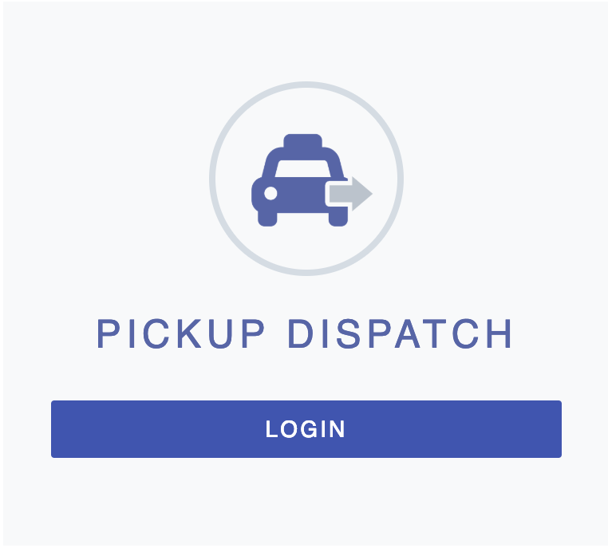
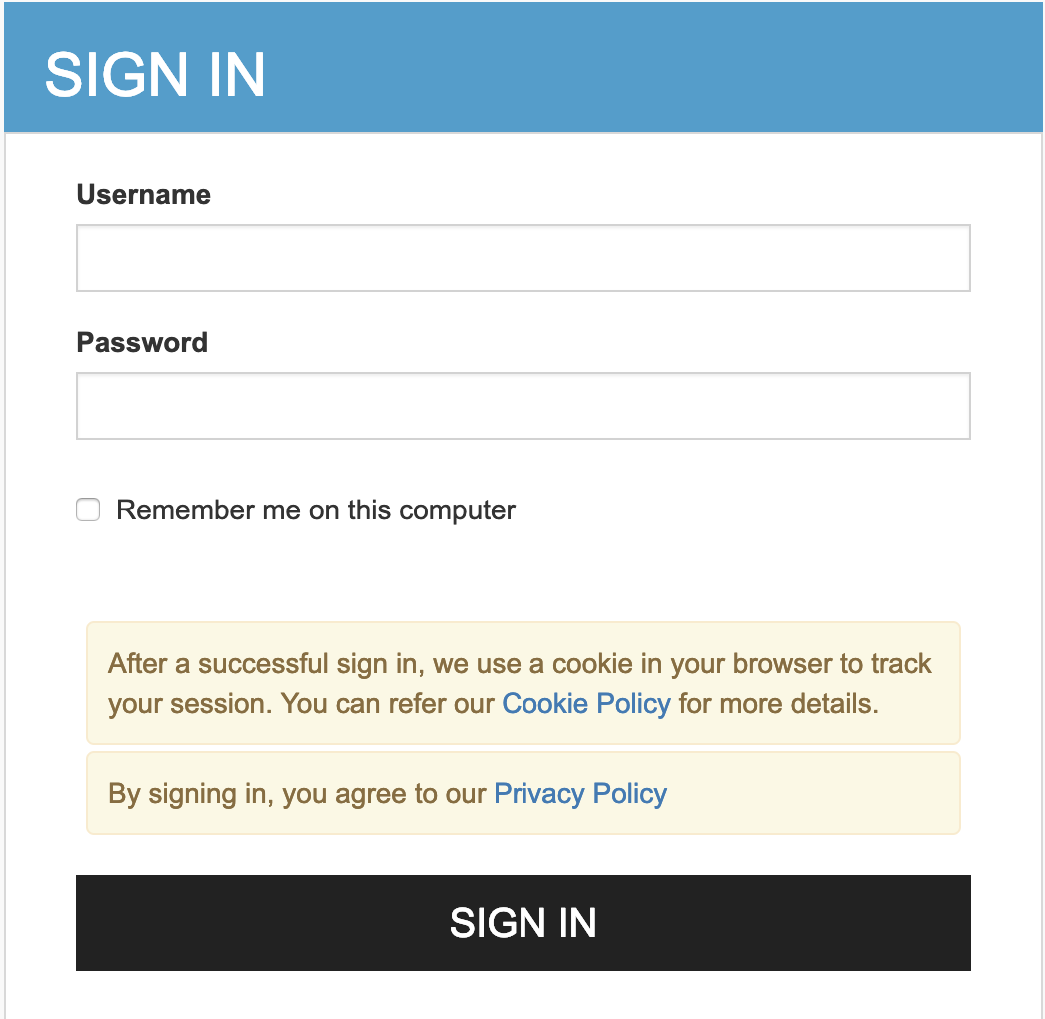
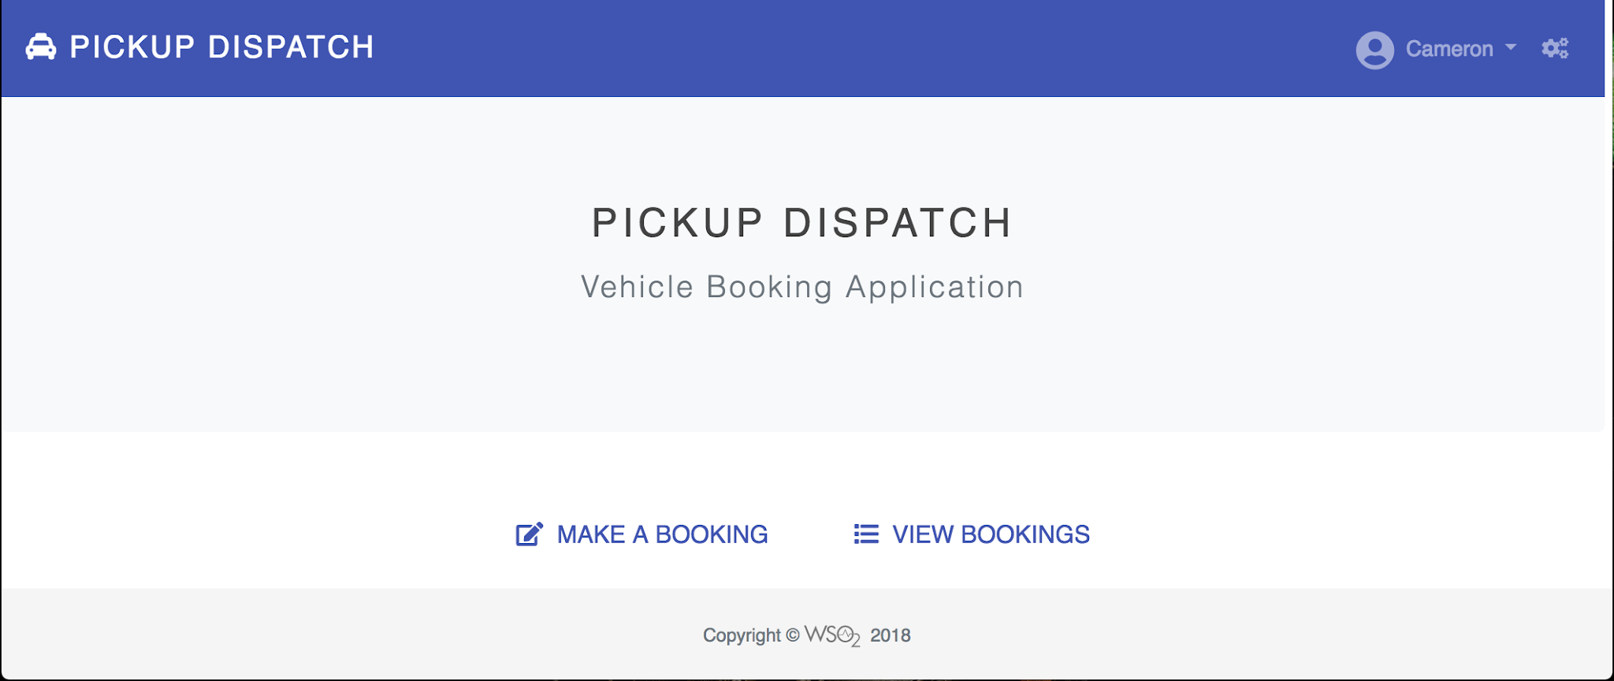
What is Authentication?
Authentication is the process used to distinctly identify a certain entity using:
  Knowledge factor: Something the user knows, e.g., password, PIN, and security question.
  Ownership factor: Something the user has, e.g., ATM card, identity card, mobile phone, and security token.
  Inherence factor: Something the user is/does, i.e., biometrics.

Slide 4
Benefits of Passwordless Authentication
Increased Security and user experience
Lower support costs
Enhanced privacy
Reduced Friction in the authentication process
Future-Proof and accessible
Helps with compliance
Versatility and Adaptability

Slide 5
Passwordless authentication mechanisms
Passkeys
Magic Link Authentication
Email OTP Authentication
SMS OTP Authentication

Slide 6
Passkeys

Slide 7
Passkeys
Based on FIDO concepts.
Authenticates users using two types of authenticators
  Platform authenticators
  Roaming authenticators
Uses public key cryptography under the hood.
Stored on a device and can be shared with other devices through the cloud or by scanning a QR code

Slide 8






Platform Authenticators
Application
Identity Provider (IdP)
Application User
[John Doe]
WSO2 Identity Server

Slide 9
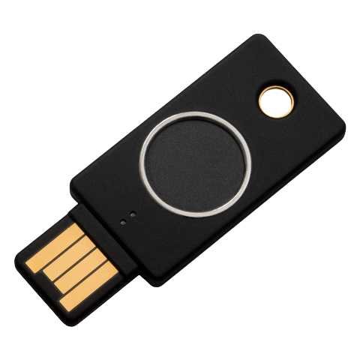
Roaming Authenticators
Application
Identity Provider (IdP)
Application User
[John Doe]
WSO2 Identity Server

Slide 10
Magic Link Authentication

Slide 11

Magic link Authentication
Username
Application
Identity Provider (IdP)
Application User
[John Doe]
@
WSO2 Identity Server

Slide 12
SMS/ Email OTP

Slide 13

SMS / Email OTP Authentication
Username
Application
Identity Provider (IdP)
Application User
[John Doe]
WSO2 Identity Server

Slide 14
Quick Recap

Slide 15

About authentication
Benefits of using passwordless authentication
Passwordless authentication mechanisms
What you learnt

Slide 16



Any Questions ?
Reach us through the following channels
iam-dev@wso2.org
https://stackoverflow.com/questions/tagged/wso2-identity-server
https://discord.com/invite/Xa5VubmThw

Slide 17
Thank you!
Notes:
Acknowledge that it’s been a lot of changes within the team
Thank you for your taking onboard the feedback and being open to change.
A lot of work , a lot of learning, sometimes feeling twice the exhaustion
But also hopefully seeing what I see, which is: better ways of working, more innovation in our approach, more business acumen, more effective reactivity , more ahead of the game. Because that’s where marketing needs to be.
All this in a context where it’s also been a lot of changes for WSO2.
And from this standpoint I wanted to remind you of what Sanjiva said about you owning the culture

